Slide 1
Mall Customers Segmentation
By Krishna shinde
(ML Engineer)

Slide 2
Problem Statement
Project Introduction
Customers who come for shopping in a mall can be grouped in a number of ways. Shopping pattern, spending pattern, shopping score, salary etc are some of the factors that can be used to divide the customers into different categories.
The reason for these clusters is to help identify those customers who would be interested in certain products, offers and services.
To create Customer cluster to identify the different types of customers

Slide 3
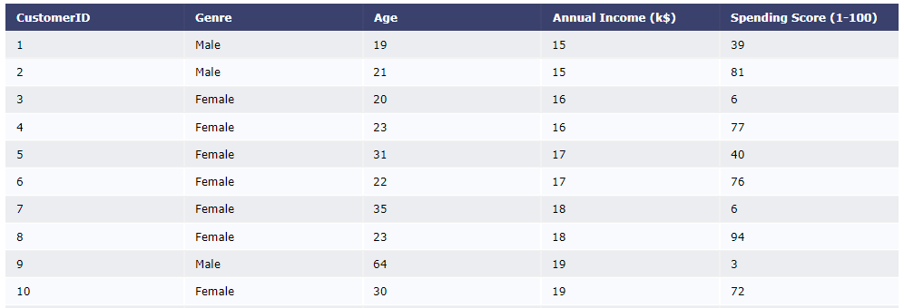
Data Source-Describe the data
This data set is provided by NIIT . It contains 200 samples and 5 features
we use unsupervised machine learning algorithms in this analysis since there are No labels over the data.
.

Slide 4
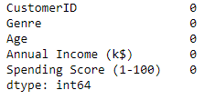
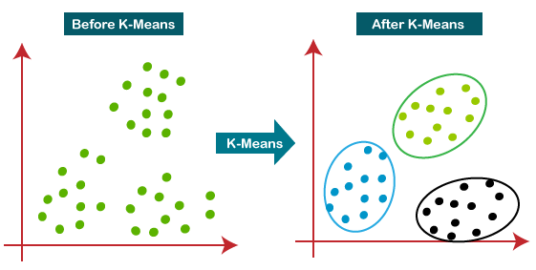
Data Treatment
What is clustering?
Clustering is basically a collection of objects on the basis of similarity and dissimilarity between them In simple words, the aim is to segregate groups with similar traits and assign them into clusters.
No Null values Found
No Duplicate values Found
No outlier Found

Slide 5
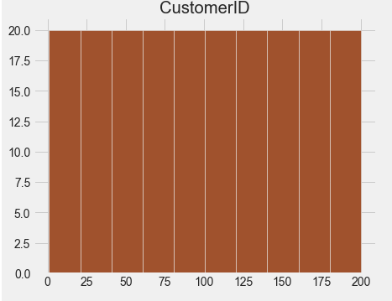
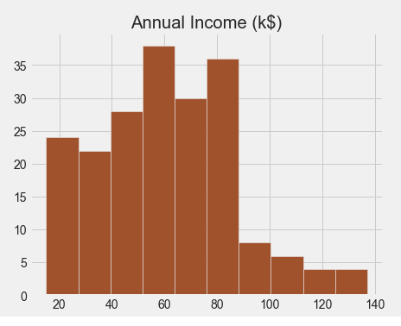
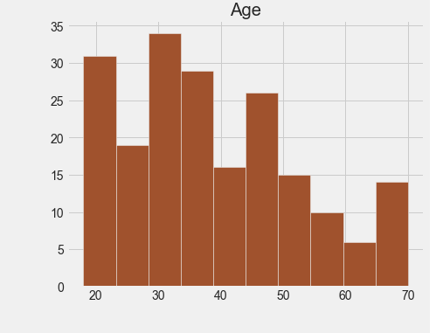
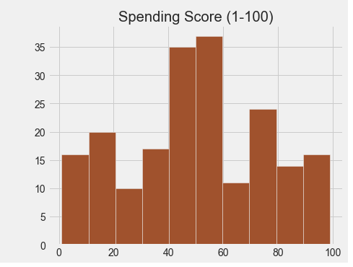
Exploratory data analysis(EDA) --univariate
Customer ID is uniformly distributed
Age is normally distributed. In age columns most people belong to 18 to 50 Age
Annual income is normally distributed. Maximum annual income 45K to 90 K
Spending Score is normally distributed. Maximum spending score is 50

Slide 6
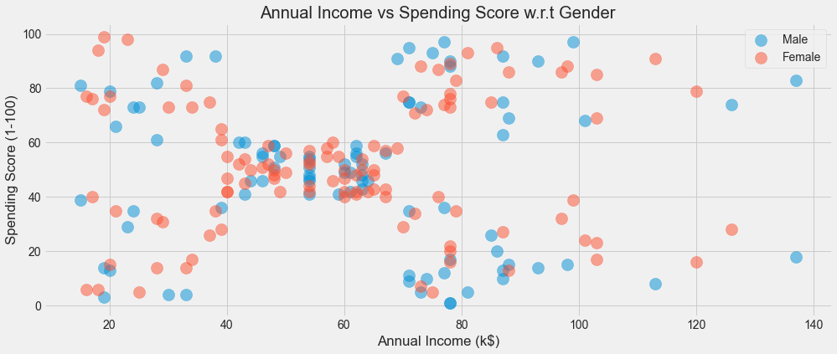
Exploratory data analysis(EDA) –Multivariate
This is scatter plot between Annual income , Spending Score and Gender.
We can observe that majority of data is divided into 5 different positions.
Male and Female are equally distributed everywhere .
x = Annual Income ($) , y = Spending Score (1-100) ,Blue =Male , Pink =Female

Slide 7
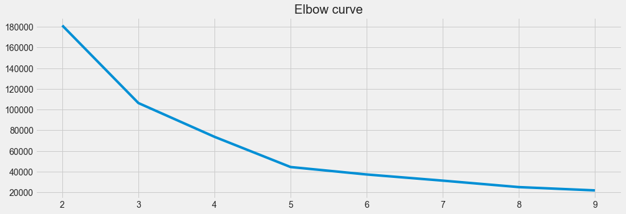
Model Building: Finding K
Elbow Curve
Elbow Method
WCSS is the sum of squared distance between each point and the centroid in a cluster. When we plot the WCSS with the K value, the plot looks like an Elbow. As the number of clusters increases, the WCSS value will start to decrease. WCSS value is largest when K = 1..

Slide 8
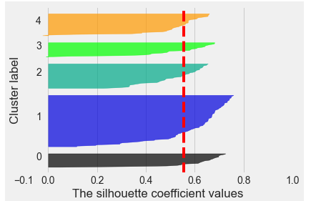
The value of the Silhouette score varies from -1 to 1. If the score is 1, the cluster is dense and well-separated than other clusters. A value near 0 represents overlapping clusters with samples very close to the decision boundary of the neighboring clusters. A negative score [-1, 0] indicates that the samples might have got assigned to the wrong clusters
Silhouette_score
For n_clusters = 2
The average silhouette_score is : 0.2968969162503008
For n_clusters = 3
The average silhouette_score is : 0.46761358158775435
For n_clusters = 4
The average silhouette_score is : 0.4931963109249047
For n_clusters = 5
The average silhouette_score is : 0.553931997444648
For n_clusters = 6
The average silhouette_score is : 0.5376203956398481

Slide 9
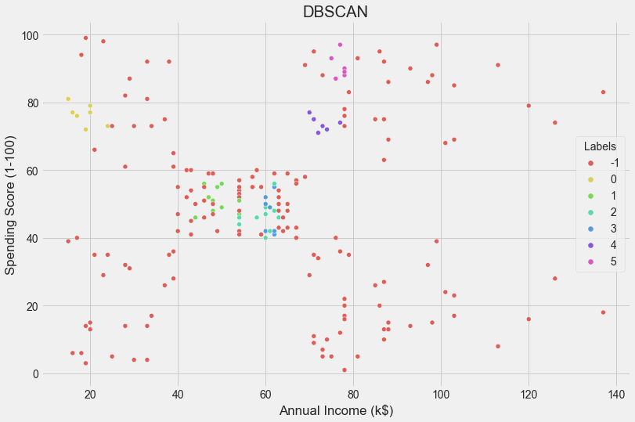
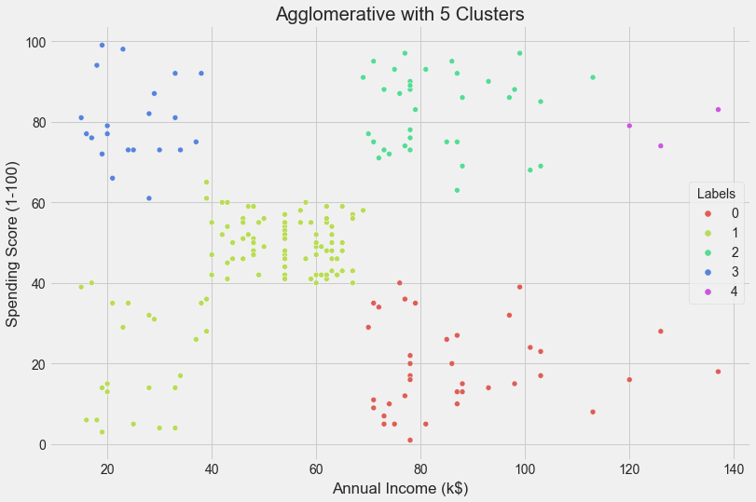
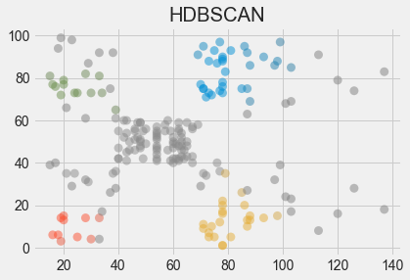
Results with other algorithms
DBSCAN
Agglomerative clustering
HDBSCAN
Agglomerative clustering uses a bottom-up approach, wherein each data point starts in its own cluster. These clusters are then joined greedily, by taking the two most similar clusters together and merging them
HDBSCAN focus on high density clustering, which reduces this noise clustering problem and allows a hierarchical clustering based on a decision tree approach
DBSCAN is a clustering method that is used in machine learning to separate clusters of high density from clusters of low density
Notes:
Asking right question
Find suitable anlysis

Slide 10
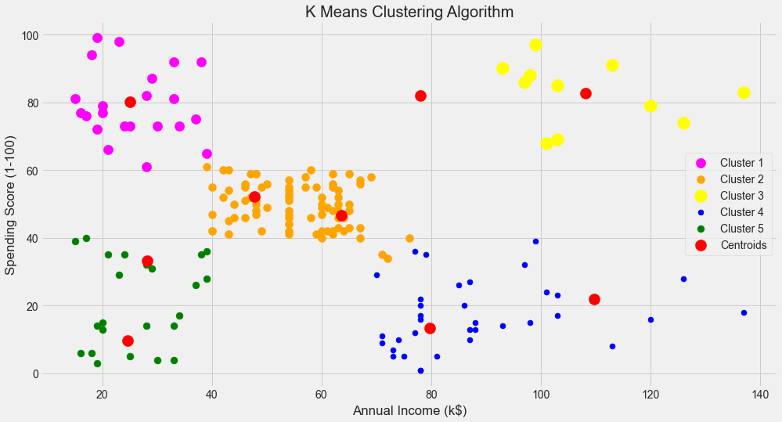
K Means Clustering Algorithm
Conclusion
#Cluster 1 (magenta Color) ->
earning less but spending more
#cluster 2 (orange Color) ->
average in terms of earning and spending
#cluster 3 (yellow Color ) ->
earning high and also spending high
[TARGET SET]
#cluster 4 (Blue Color) ->
earning more but spending less
#Cluster 5 (Green Color) ->
Earning less , spending less
Awesome! Here, we can clearly visualize five clusters. The red dots represent the centroid of each cluster.

Slide 11
Thank you!!!

